Slide 1
Tensorflow DFT Layer
By: Oisín Watkins

Slide 2
Contents
Where We Left Off
Newest Updates
Comparison with the “Done Thing”
Closing Remarks

Slide 3
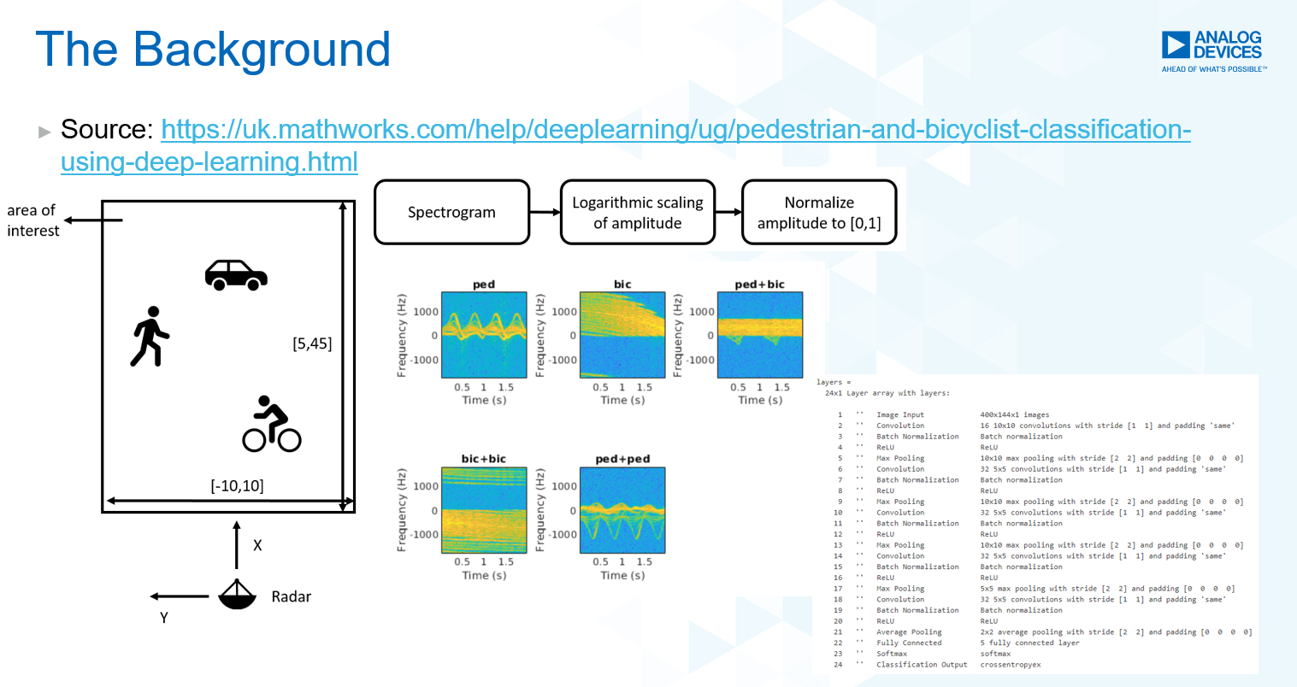
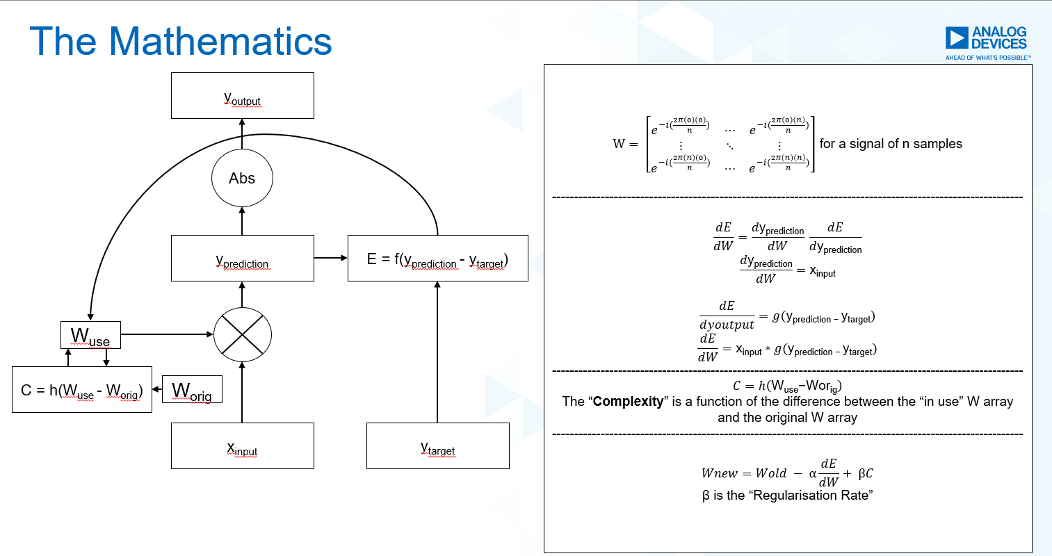

Where We Left Off

Slide 4
Newest Updates

Slide 5
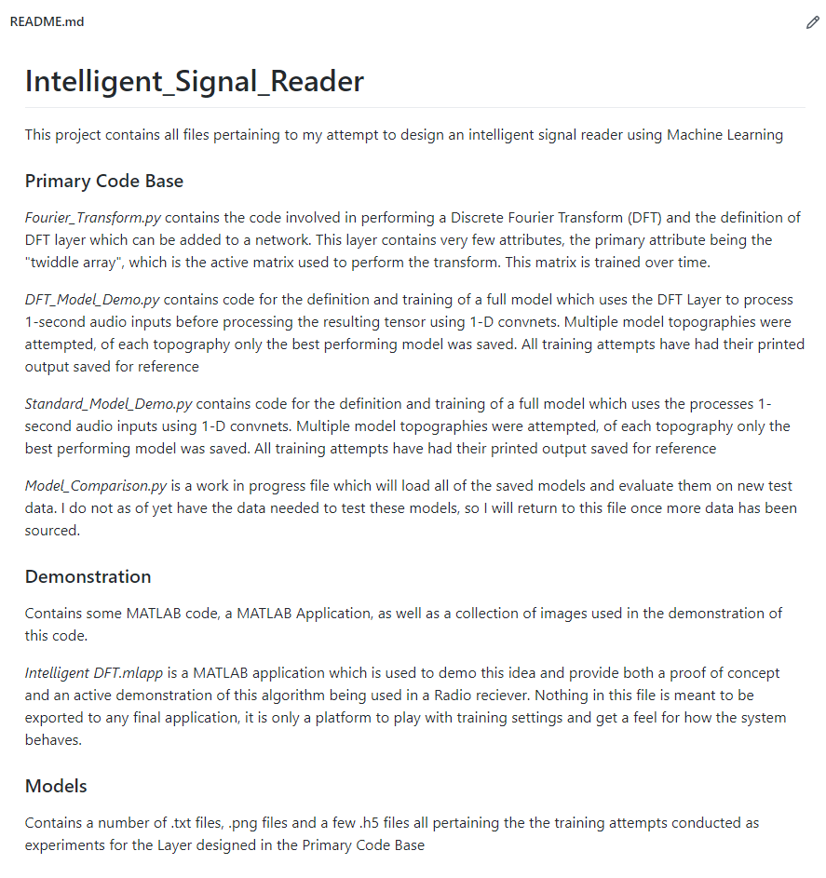
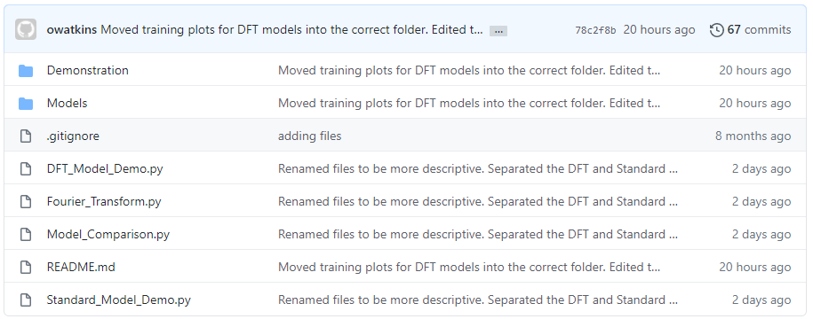
Newest Updates

Slide 6
Comparison with the “Done Thing”
Sadly I don’t have very many visualisations for this section, You’ll have to bear with me…
For the sake of comparison with typical signal processing methods in modern AI, I chose a dataset that was used in an international Machine Learning competition hosted by Kaggle:
Speech Recognition

Slide 7
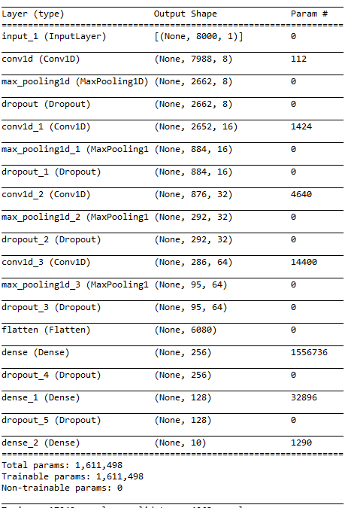
Comparison with the “Done Thing”
Just a few comments on this “Done Thing” Layout:
Using a series of 1-Dimensional Convolutional layers as shown on the left is quite common when dealing with Audio data.
The bottom layers (after the Flatten) make up what’s known as the Classifier. This block of the model forms the decision-making algorithm for your system. A flaw with this “Done Thing” is that you end up with top-heavy models (the first Dense layer has over x100 the number of parameters in the next biggest layer)
Given the linear nature of the model all computations are run in series. On computers this leads to a longer processing time, in systems where memory / RAM is limited it can lead to a processing bottleneck.
Conv1D layers require 2-D data for their inputs. Given this audio data it must be cast into 2-D from 1-D. This is no problem for accuracy, but it does mean the system is required to perform this shape-change for every input.

Slide 8
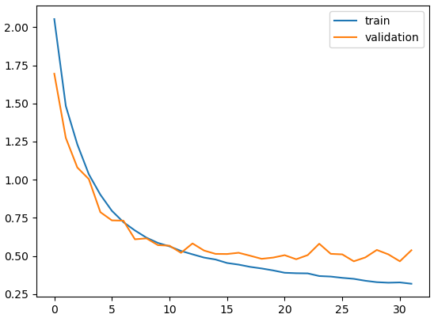
Comparison with the “Done Thing”
This is a plot of Training Loss and Validation Loss over Epoch for the standard model:
Starts to over-train at epoch 12.
Takes 32 epochs to train before “Early Stopping” callback triggers.
Otherwise has a very decent performance. ~0.5 loss value on validation data.
You’ll see on the next slide that each input takes 8-9ms to process.
Achieved a final validation accuracy of 84.14%

Slide 9
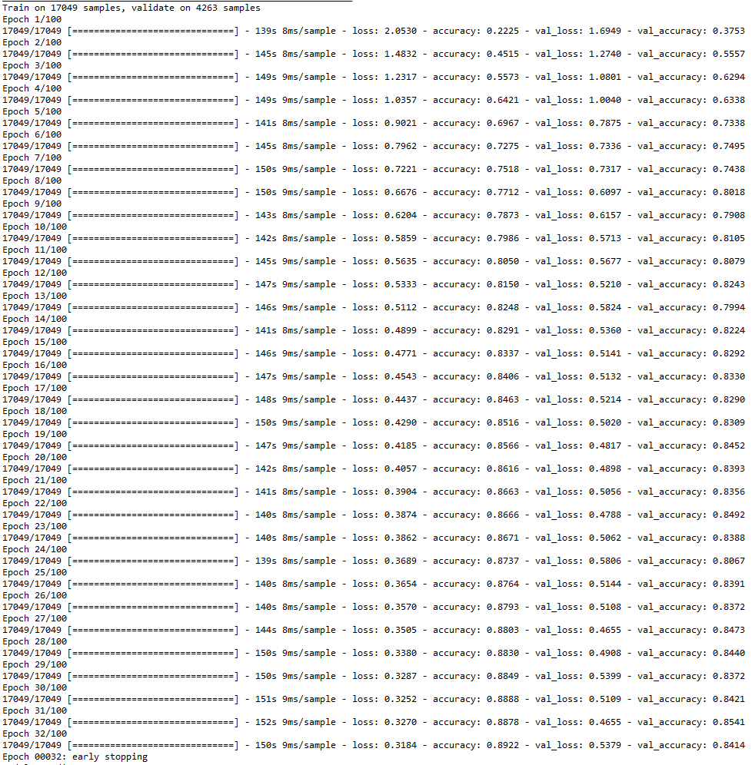
Comparison with the “Done Thing”

Slide 10
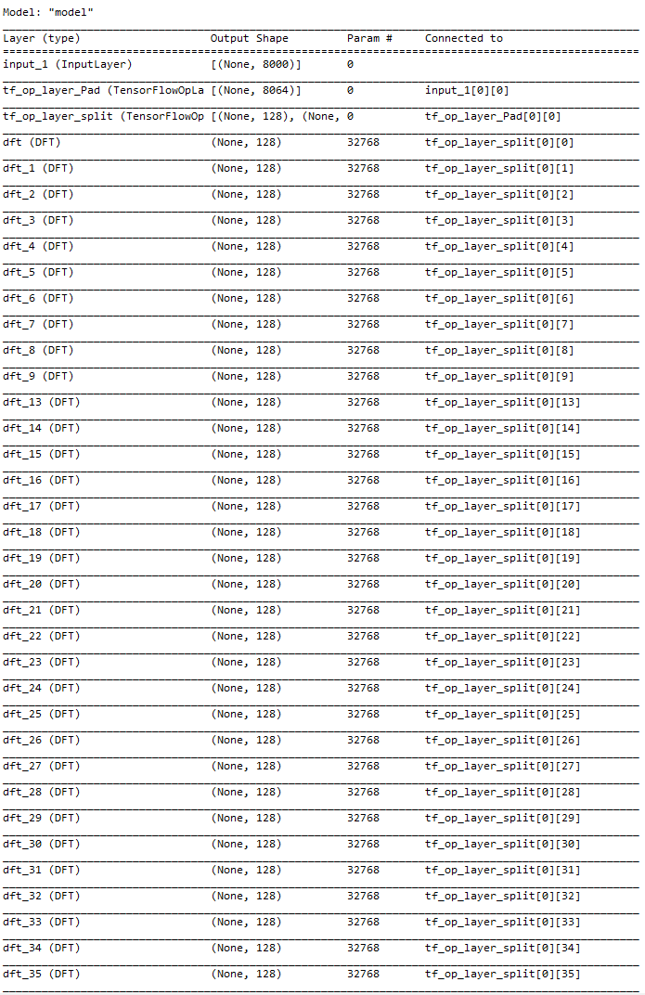
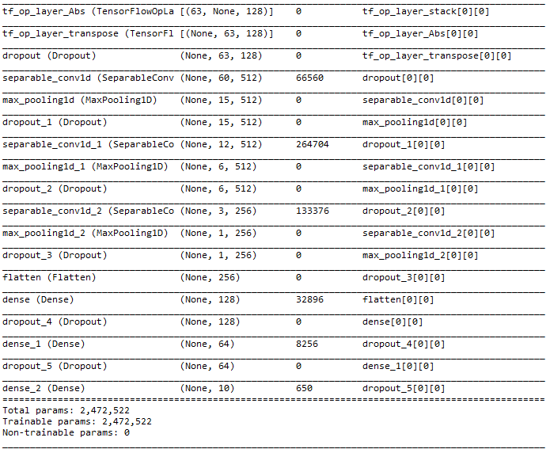
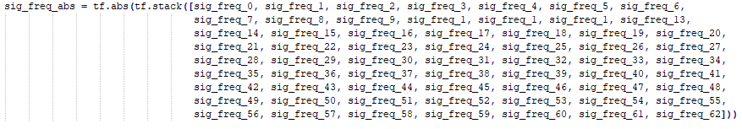
Comparison with the “Done Thing”
A few comments on this layout (regrettably it’s very difficult to capture this model in one picture):
Roughly 800,000 (50%) more parameters than the standard model, however 2,064,384 (63 * 32,768) parameters are used only in the parallel DFT layers.
Given that the overwhelming majority of parameters are devoted to a parallel computation, this model runs anywhere from 2x to 3x faster than the standard model
No individual layer handles an excessive amount of the processing, the largest layer has roughly 2x the number of parameters as the next biggest layer. The classifier is a very reasonable size in comparison to the rest of the model.
The DFT layer accepts 1-D data, so no shape changing on the input. A transpose is required after the DFT outputs are stacked together, however this is computationally cheaper than a reshape.

Slide 11
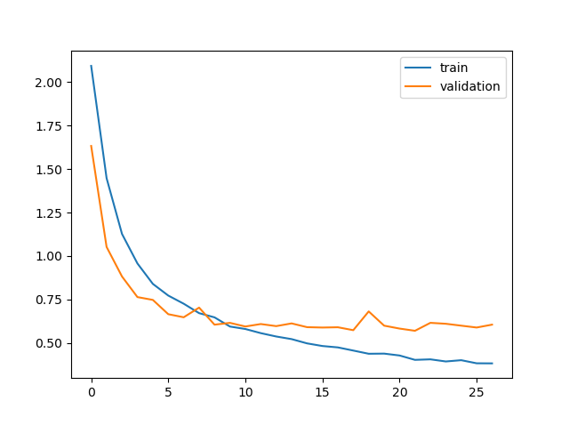
Comparison with the “Done Thing”
This is a plot of Training Loss and Validation Loss over Epoch for one of the DFT model layouts:
Starts over-training at epoch 9.
Takes 27 epochs to train before “Early Stopping” callback triggers.
Slightly worse performance with roughly 0.6 loss on validation data.
You’ll see on the next slide that each input takes 3-4ms to process.
Achieved a final validation accuracy of 82.34%

Slide 12
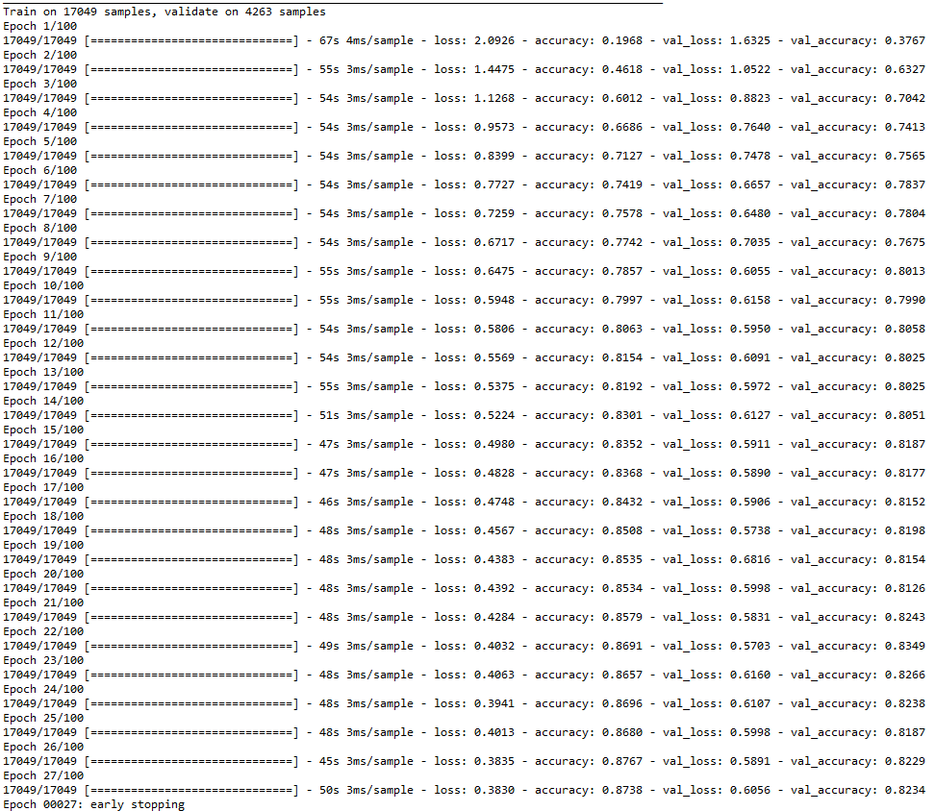
Comparison with the “Done Thing”

Slide 13
Closing Remarks
Having validation accuracies within a few percent of each other would indicate that when tested on new data both the standard model and the DFT model would perform similarly well.
The issue of over-training in the DFT model can be solved using a couple of techniques: Augmentation (I avoided this as the standard model was not trained with Augmented data, the comparison would have been unfair) and Batch Normalisation (which I did attempt to great success, view next slide for details) and using a Flatten layer before the Classifier block (which I also attempted) would be the first 3 to consider.

Slide 14
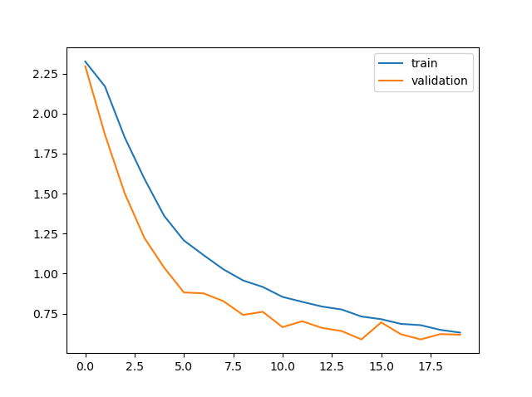
Closing Remarks
Notice now how the system never over-trains.
To achieve this Batch Normalisation was performed between each cluster of Conv1D, Maxpooling1D and Dropout layers.
There was also a Flatten layer just before the Classifier block. This increased the size of the Classifier by ~2000 parameters, which is hardly a noticeable difference. This layer is used to reshape the data going into the Classifier block so that the Classifier does not have to handle that reshaping in its topography.
The only issue with this implementation is a drop of a few % in accuracy. This model capped at 80.39% with a loss value of 0.6186 on the validation data.

Slide 15
Closing Remarks
So in summary:
The DFT layer achieved very similar results as the “Done Thing”.
The DFT layer was anywhere from 2x to 3x faster than the “Done Thing”.
The DFT layer trained in fewer epochs that the “Done Thing” required.
The DFT layer saw marginally worse accuracy and loss values on validation data.
The DFT layer over-trained quicker than the “Done Thing”, meaning more effort would be needed to combat the trend.
Despite the speed bonus, the DFT layer does require 50% more parameters than the “Done Thing”.
2 of the 3 drawbacks can be accounted for with some careful preparation and thoughtful training. The memory issue is one which could only be combatted by reducing the depth and breath of the deeper layers in the network.

